Slide 1
Overview of speech signals & speech processing
COMP.SGN.120
Introduction to Audio and Speech Processing
Lecture 9

Slide 2
Contents of today
Part #1: What is speech & speech processing
Part #2: Typical speech technology applications

Slide 3
Part #1: What is speech

Slide 4
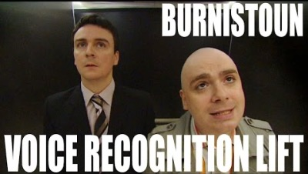
https://www.youtube.com/watch?v=TqAu-DDlINs

Slide 5
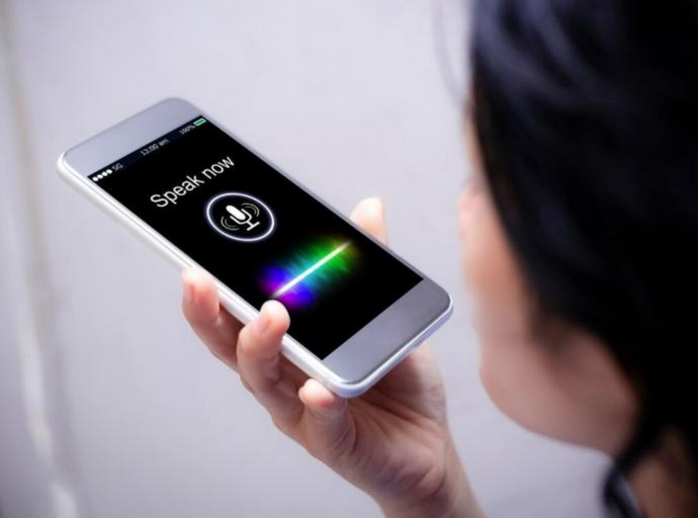
On speech
Speech is the primary means of human communication (and the primary form of language).
Speech is easy
Speech is effective
Speech is everywhere
Written language (text) is secondary to us (in culture, individual development and in social interaction).
Speech is human. Speech technology is about assisting, improving and studying humans and their communication.
Source: TechRepublic

Slide 6
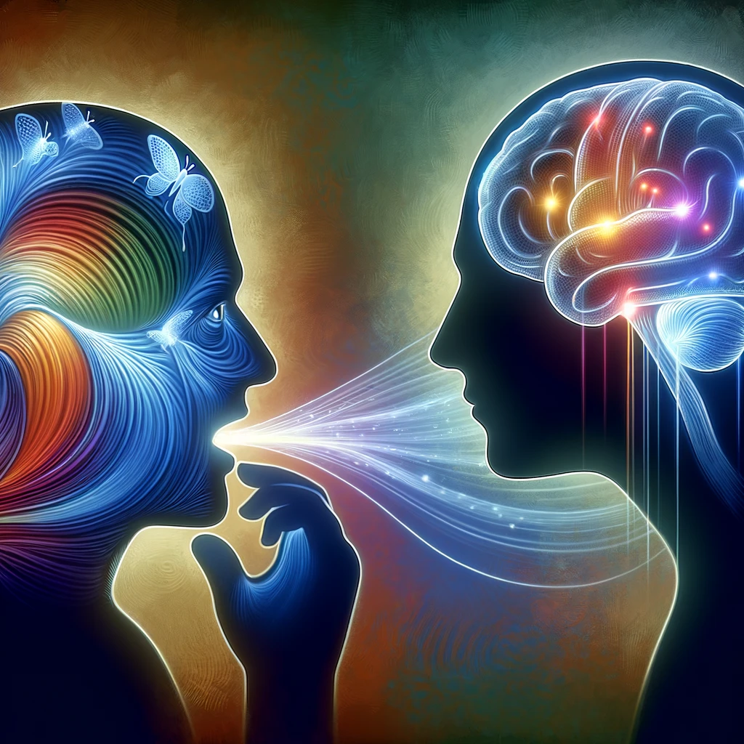
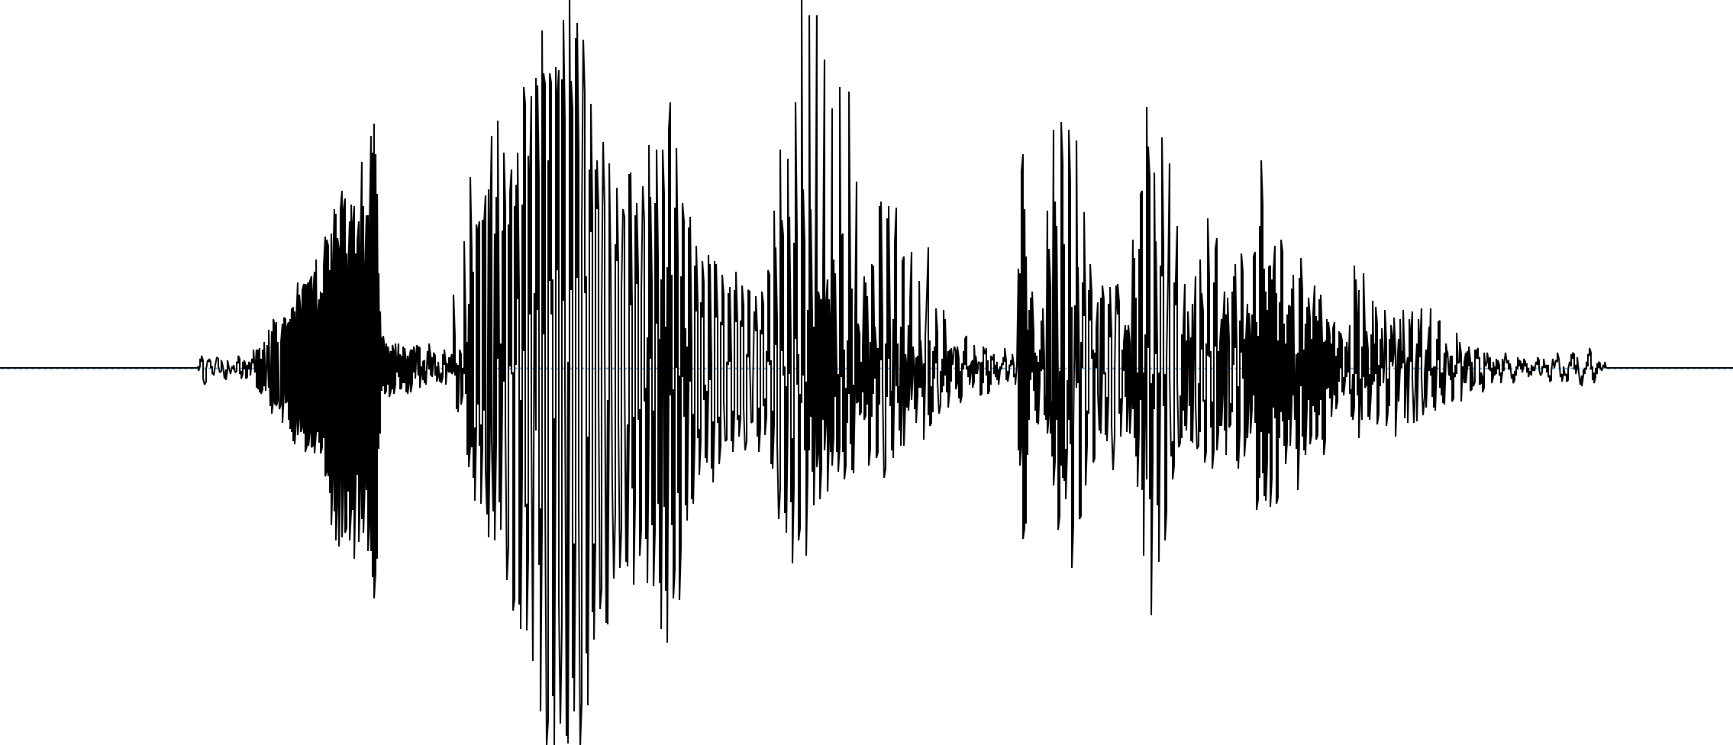
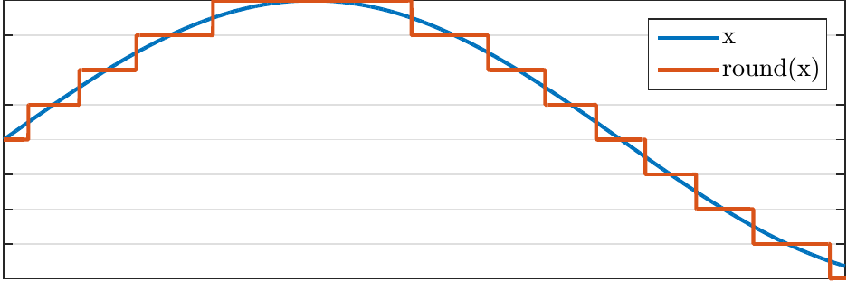
What is speech?
+Culturally: a system
of shared conventions
Conceptually: a highly versatile way of communication between a talker and one or more listeners.
Linguistically: Dual nature (aka. “double articulation”): non-meaningful elements (speech sounds, syllables) that make up meaningful symbols when combined (words, sentences).
[ə] [k] [æ] [t] [k] [ɹ] [ɔ] [s] [t] [ð] [ə] [s] [t] [ɹ] [i] [t] : “A cat crossed the street”
Cognitively: altering the brain activity and thereby behavior of other humans.
Physically: temporal air pressure variations (= an acoustic signal) that convey meanings.
Digitally: bits encoding waveform amplitude at discrete time intervals values or bits representing features derived from the waveform.

Slide 7
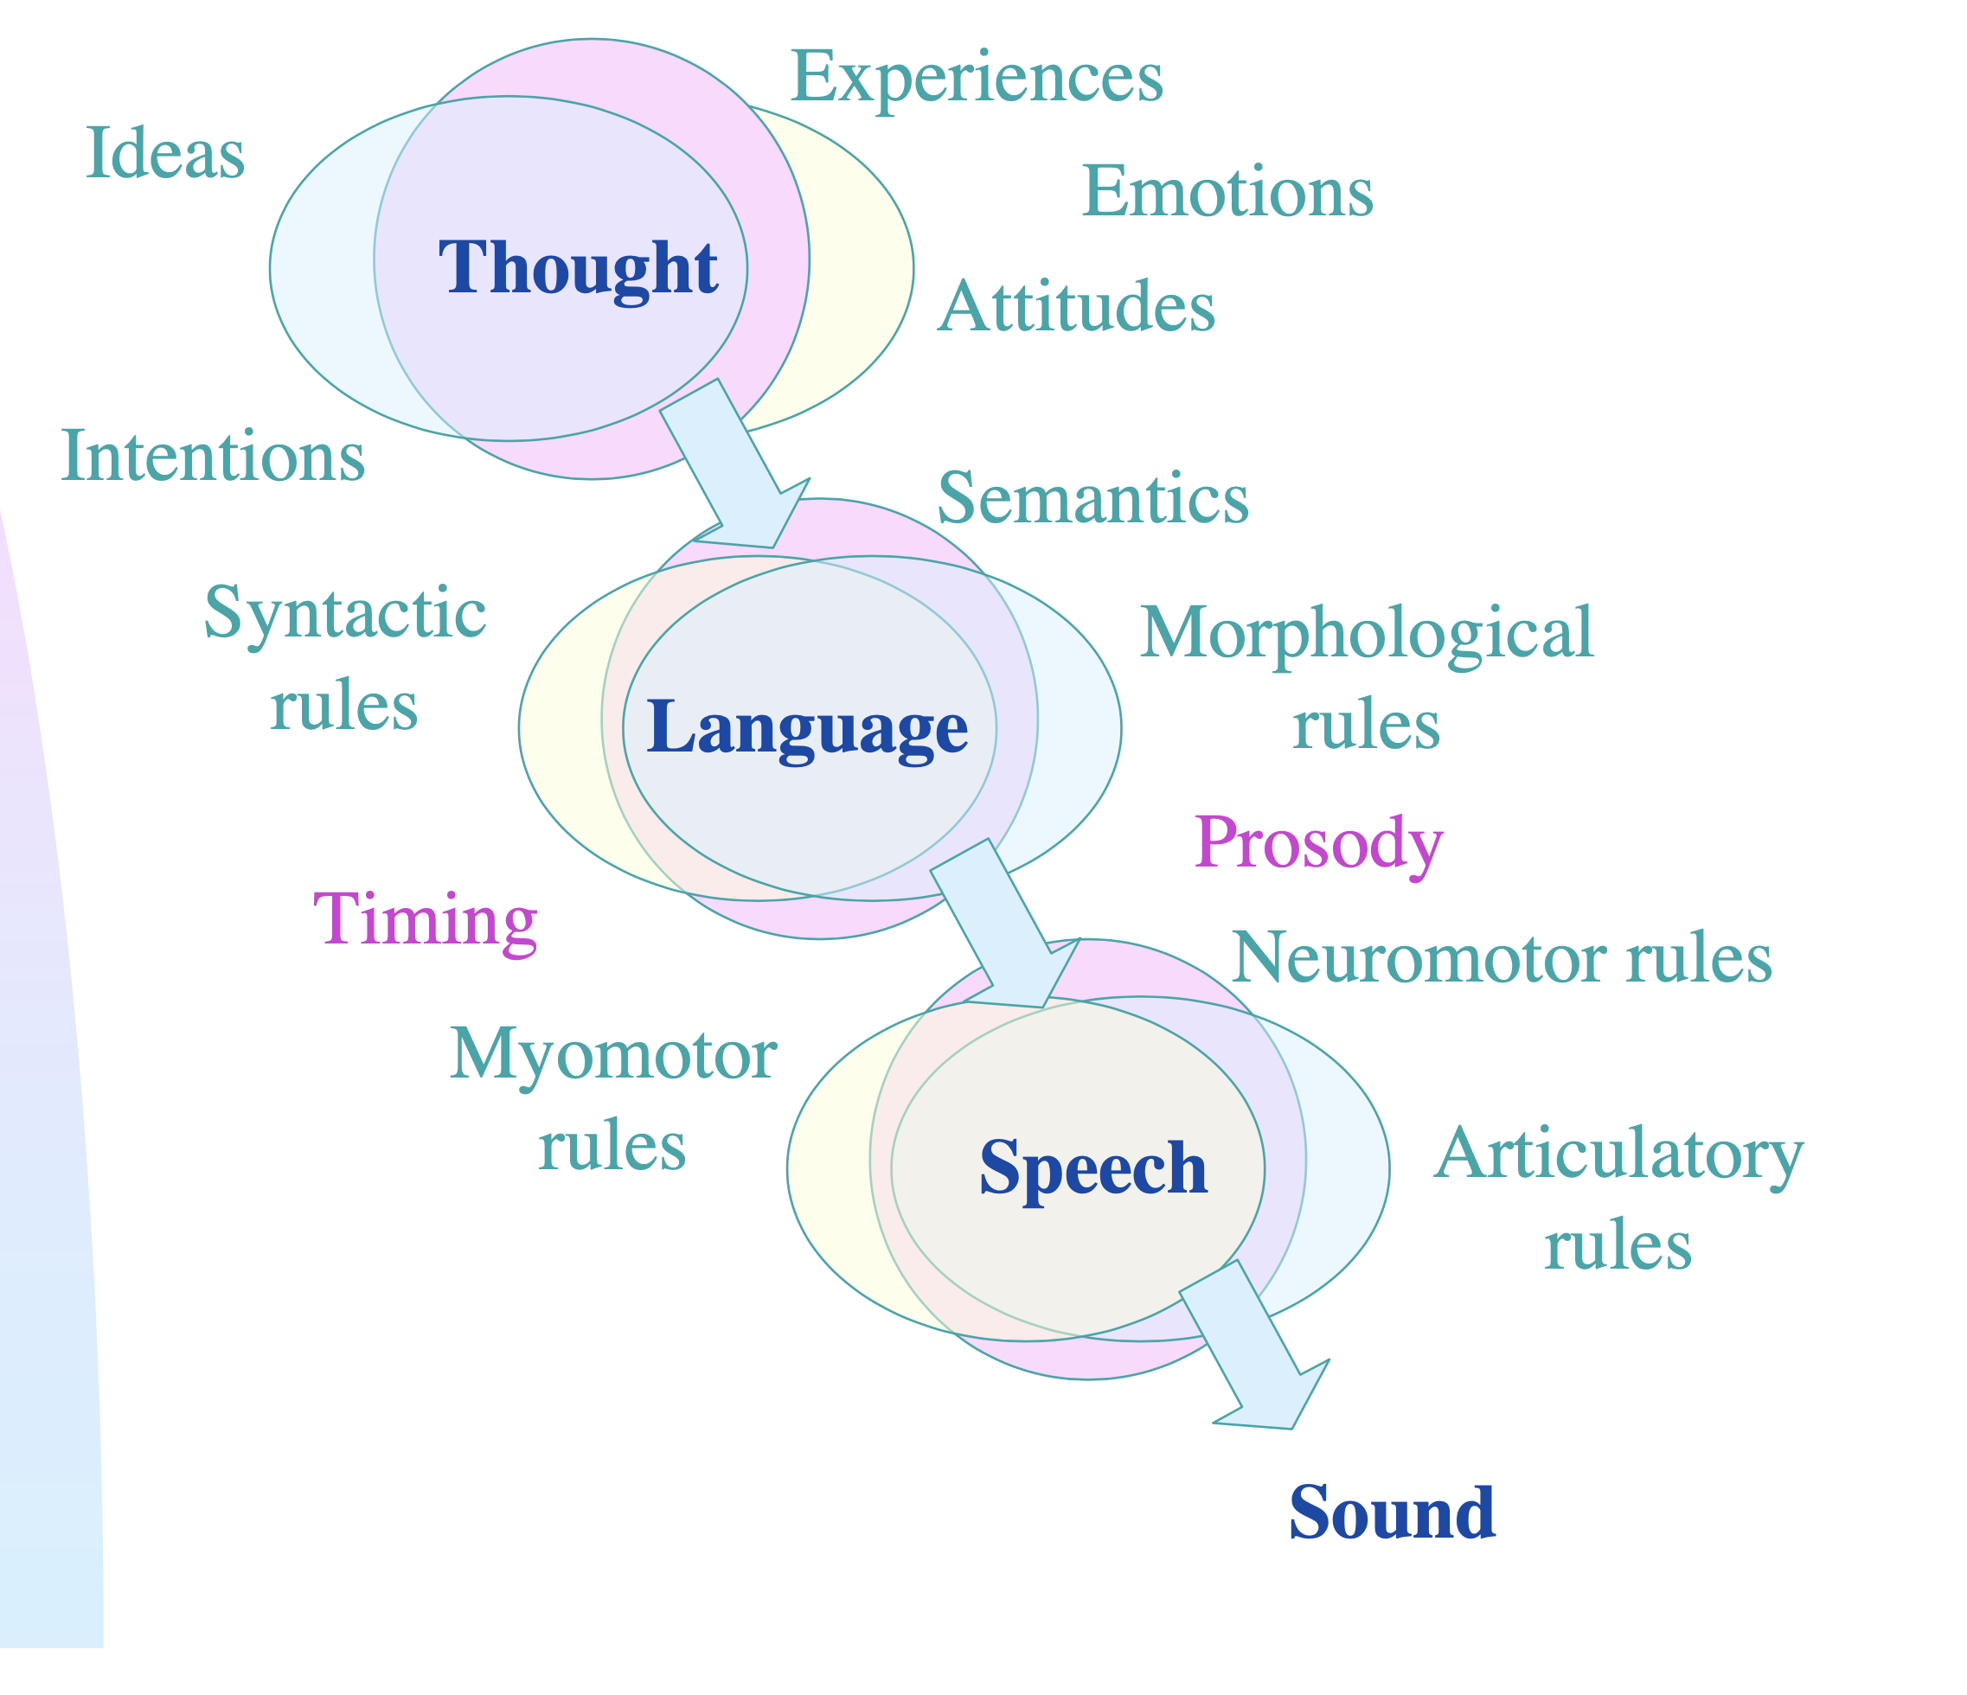
Speech as a phenomenon
Bodily states
Prosody
Timing
Listener model
Environment model
Self-monitoring (auditory, somatosensory)
Originally by Unto K. Laine, 99, modified by O.R.

Slide 8
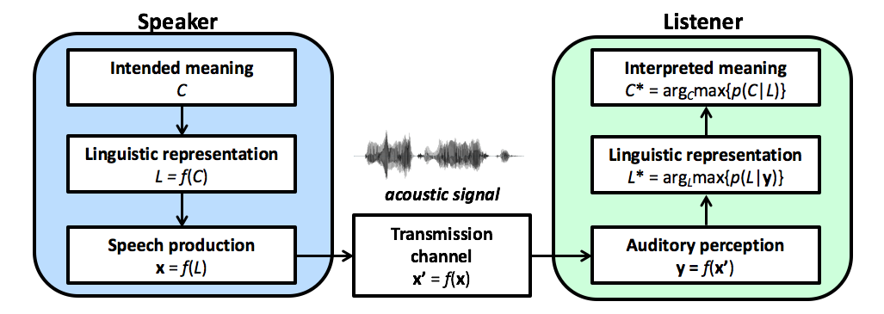
Speech chain
Speech signals are based on intricate interaction of neural and physiological aspects of 1) speech production, 2) acoustics, and 3) hearing.
Verbal communication process can be simplified as the speech chain.

Slide 9
Why speech is a special acoustic signal?
The speech signal
…conveys meanings through non-meaningful elements.
…is always intentional (communicative intent).
…is always personal (informs of the talker and is tailored to audience).
…occupies a particular acoustic subspace/manifold of all possible sounds (as constrained by the speech production apparatus).
…is optimized for efficacy of human-to-human communication*.
Overall, the signal is very rich in information.
*Not always optimal though

Slide 10
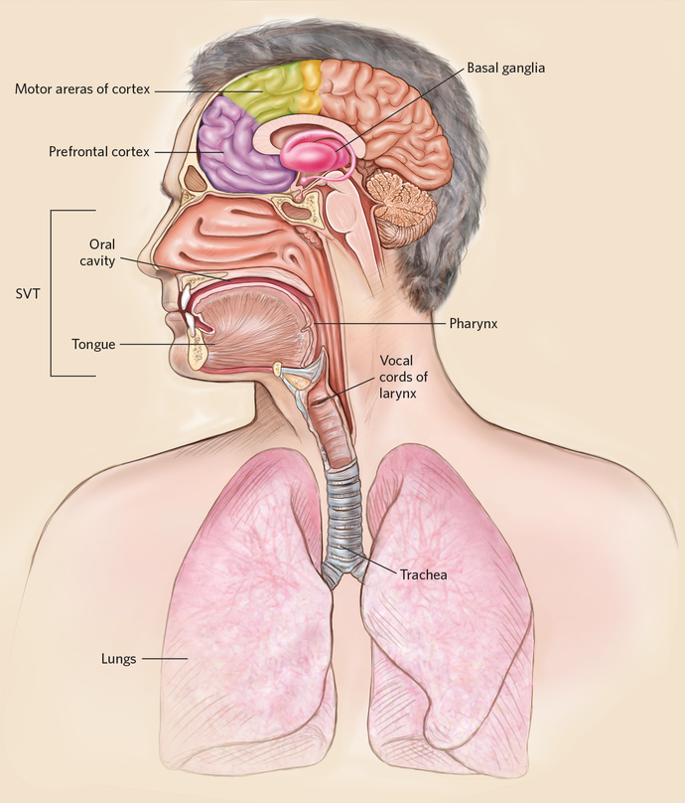
An overview of speech production
Brain: conversion of an “idea-to-be-communicated” into a sequence of motor commands.
Lungs: provides air-pressure through contraction.
Vocal folds: periodic vibration due to lung-pressure + motor control
Vocal tract: articulators (tongue, lips, jaw etc.) filter the signal in time according to neural control
Lips + nose: sound radiation to external environment.
(more about production on Thursday’s lecture)
Source: The Scientist Magazine

Slide 11
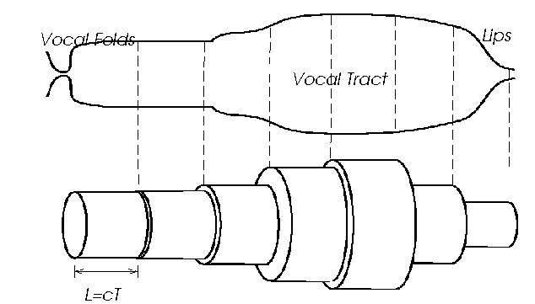
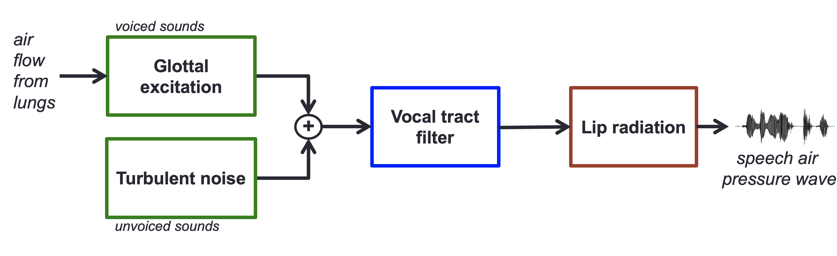
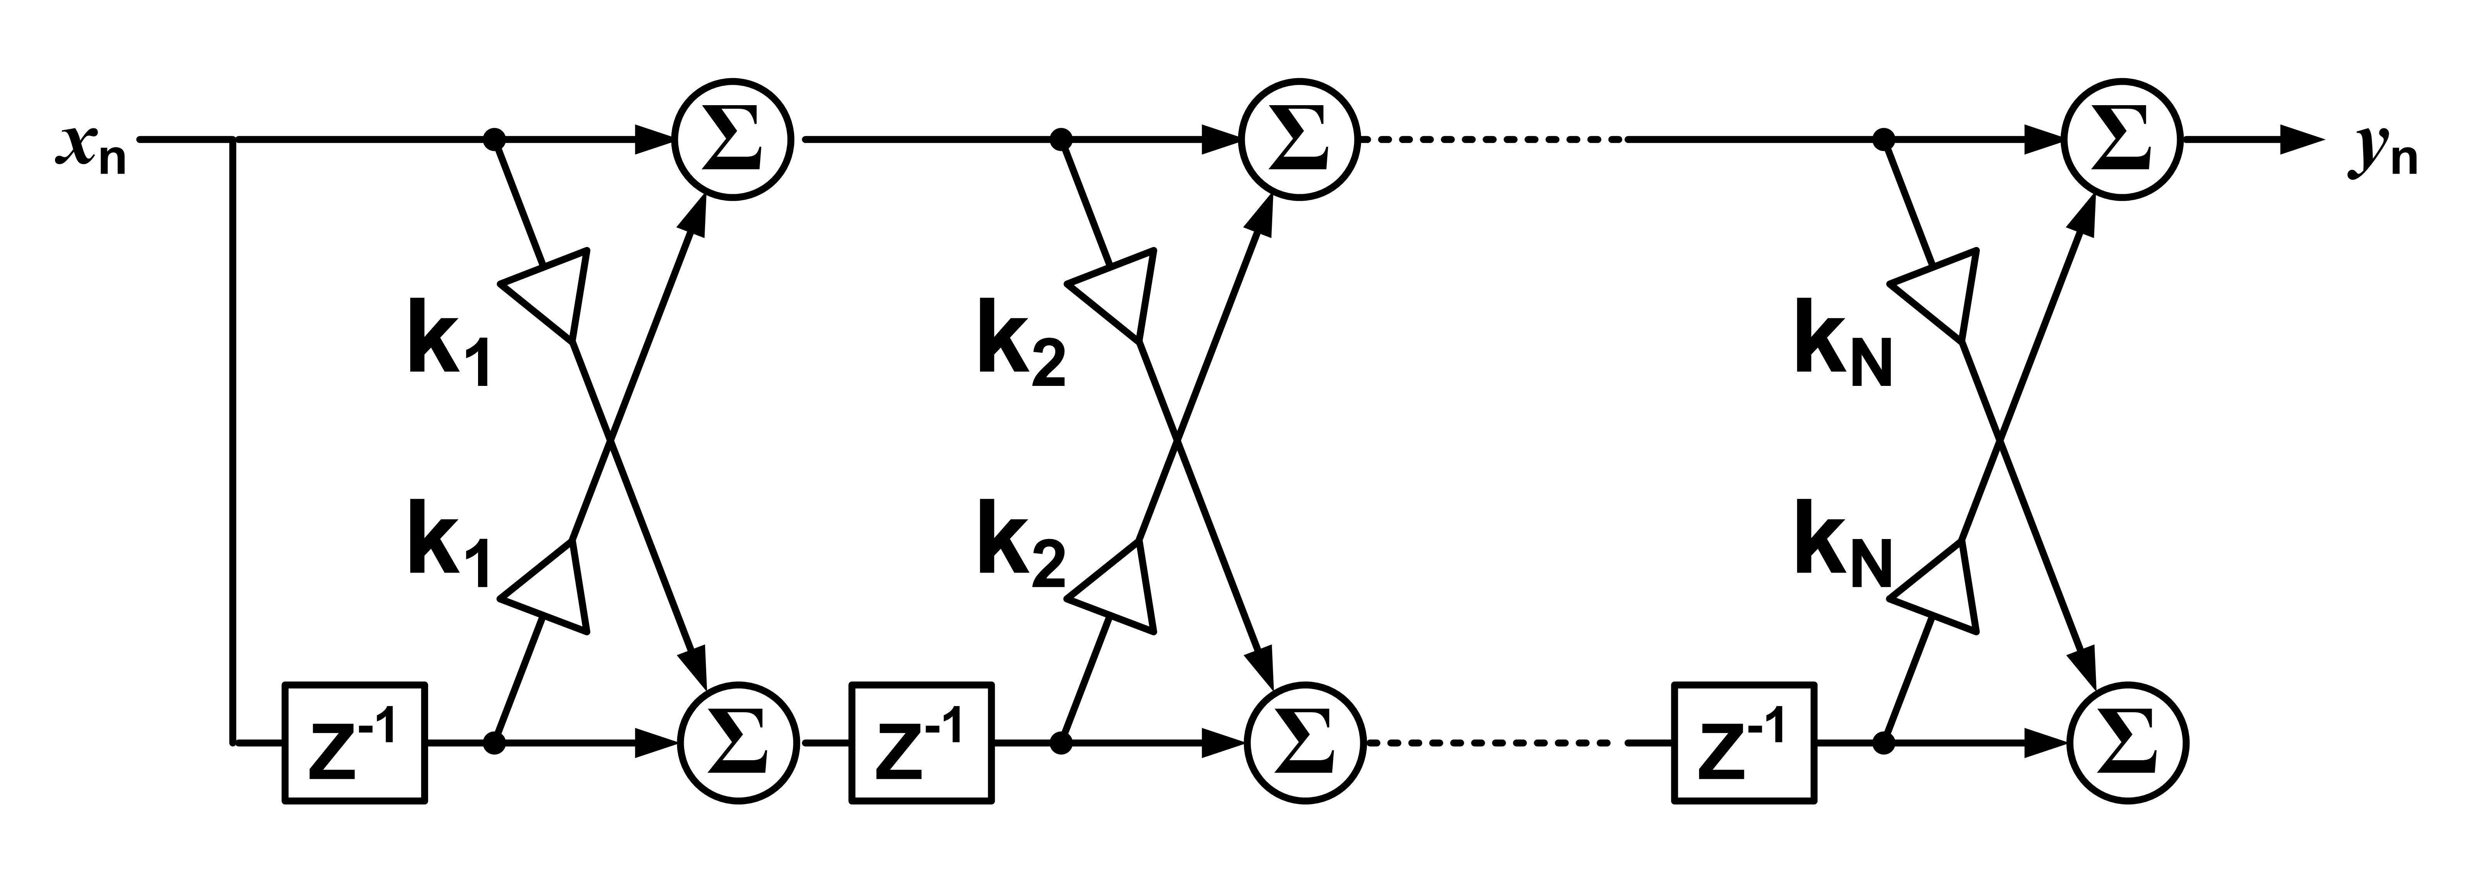
Acoustical modeling of speech production
physiological systems
h(t)
r(t)
s(t)
y(t)
acoustic tube models
LTI-modeling:
y(t) = s(t) ∗ h(t) ∗ r(t)
Y(f) = S(f) × H(f) × R(f) = F{s(t)} × F{h(t) × F{r(t)}
Speech production can be modeled using physics, electronics, or digital signal processing (DSP) techniques.
digital filters

Slide 12
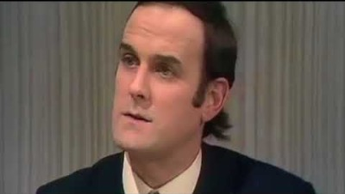
Information content in speech
https://www.youtube.com/watch?v=ohDB5gbtaEQ

Slide 13
Information content in speech
Speech is rich in terms of information:
Phonological and lexical content (linguistic message)
Prosodic content (how the linguistic content is delivered)
Personal content (speaker identity, traits and states, emotions; also recipient identity)
Acoustic signal also conveys transmission- and situation-related content (e.g., distance and positioning of the talker, ambient sounds, size of the room etc.)
Sometimes divided into linguistic and paralinguistic content.

Slide 14
Speech as an acoustic signal
Why speech is difficult?

Slide 15

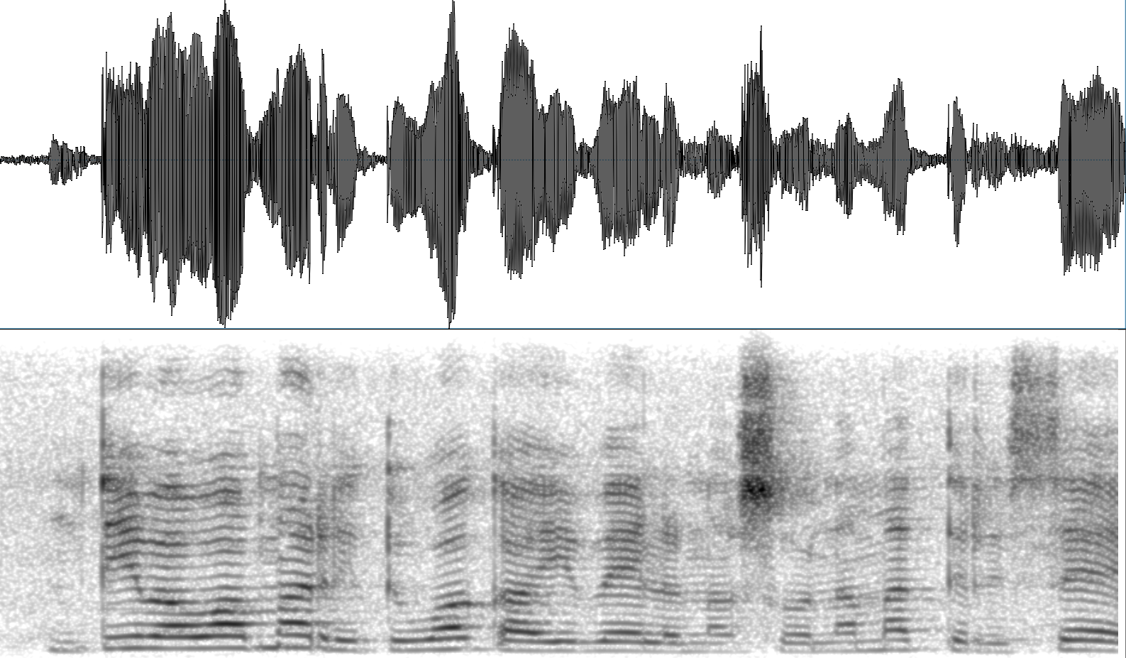
Demonstration
Can you recognize the words?
…can you count the words?
…can you see the words?
amplitude
8000 Hz
frequency
0
0
time
3.6 s
“ntivovomarito wa kayivela naswona matirhise”

Slide 16
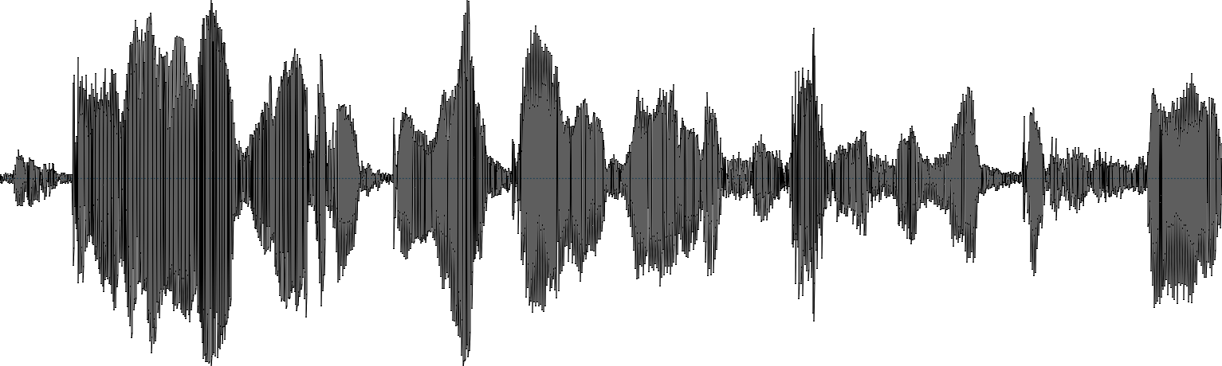
Speech as an acoustic signal
Unlike text, acoustic speech does not contain obvious cues for unit boundaries (cf., letters and words).
Acoustic characteristics of speech units vary: even the same word never sounds the same.
Factors: temporal context, speaker, speaking style, dialect, emotional state, background noise, motor control precision, and many more….
Same sounds/words can mean different things to different listeners (e.g., different language)
Still easy to understand for humans. How to achieve the same with machines?
3 vowels 3 consonants
?
?
?

Slide 17
What is speech processing
Speech processing = analysis, manipulation, and generation of speech signals by digital means.
At the intersection of speech sciences, digital signal processing, and machine learning.
Roots in electrical/telecommunication engineering, modern approaches increasingly based on computer science.
Natural Language Processing (NLP) = (mostly) processing of text data.

Slide 18
Why speech processing
The modern world is digital, speech is analog and physical.
Speech processing is needed for transforming real-world communication into digital format and back.
E.g., speech-to-text, text-to-speech, mobile phones, voice over IP.
Speech processing is needed to process & interpret spoken language data with machines.
Voice commands, robotics, personal digital assistants (Siri, Alexa, Google assistant), etc.
Speech-based analytics (e.g., health or emotions).
Speech processing is needed for studying and analyzing verbal communication.
Linguistics, neuroscience, psychology, social sciences…

Slide 19
What is speech processing
Phonetics
Physiology
Psychoacoustics
Acoustics
Speech processing
Natural language processing
Machine learning
Digital signal processing
Linguistics
Psychology
Information theory

Slide 20
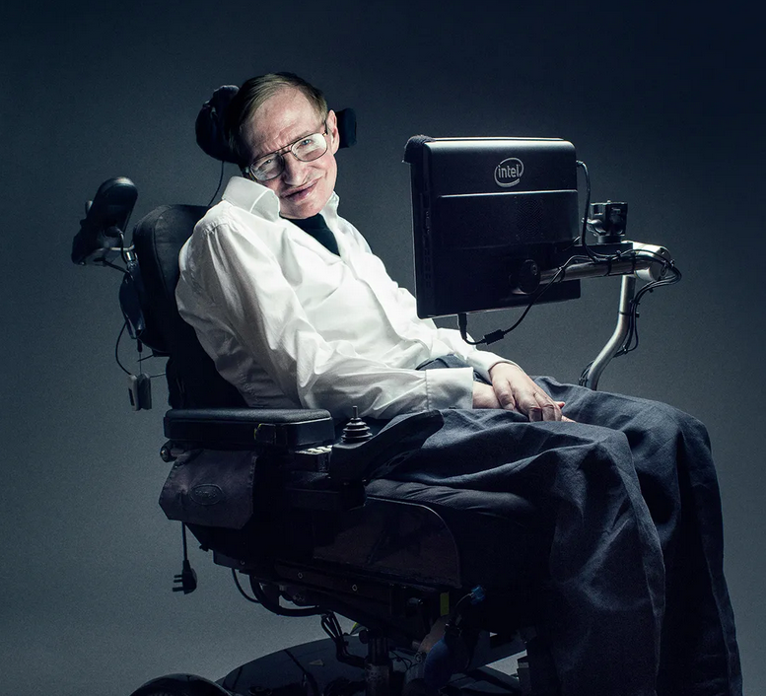
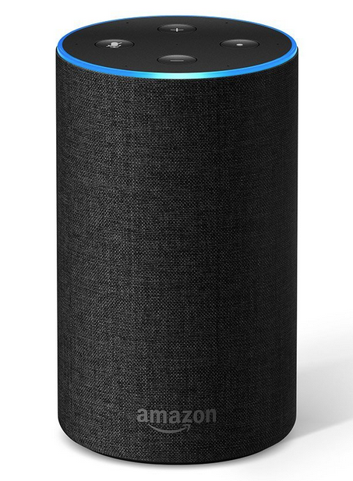
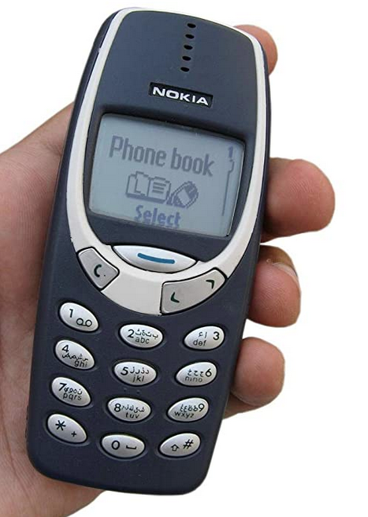
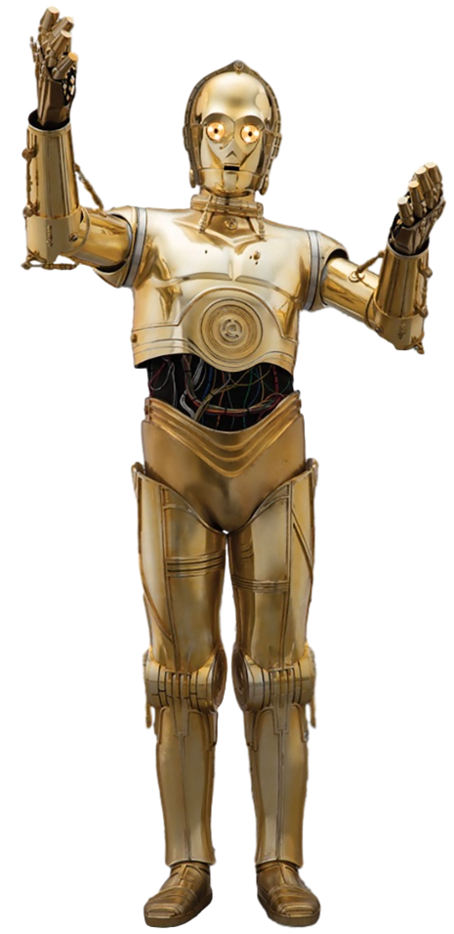
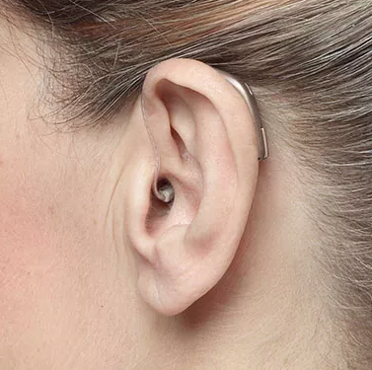
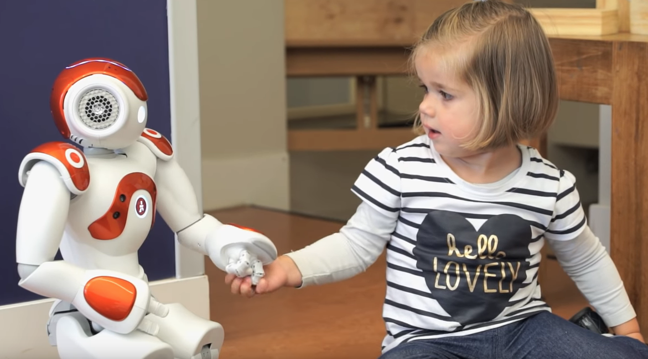
Photo by Marco Grob / Wired UK
Photo from Oticon

Slide 21
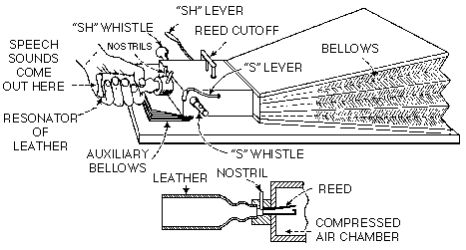
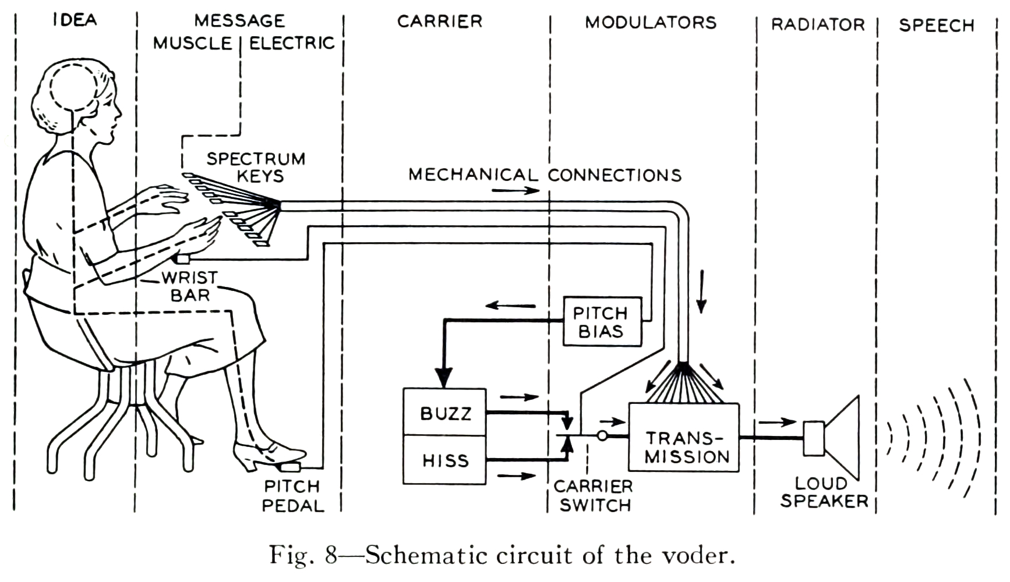
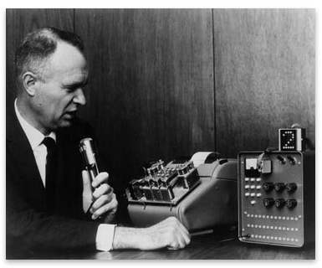
Some historical notes
1779: First published vowel synthesis by Kratzenstein
1791: The first manually controlled synthesis system by Von Kempelen.
1939: The first electronic speech synthesizer: VODER / Bell Labs.
1952: The first speech recognizer: Audrey / Bell Labs (for digits 0–9).
1961: Bell Labs Shoebox recognizer for digits + some extra words.
1968: First text-to-speech system (Umeda et al.) / Electrotechnical Laboratory, Japan
1971–1976: DARPA Harpy speech recognizer. Automatic recognition of around 1000 words. Link
1991: World’s first digital mobile phone call from Helsinki to Tampere (GSM network)

Slide 22
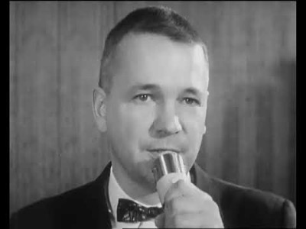
Bell Labs Shoebox (1961)
https://youtu.be/rQco1sa9AwU

Slide 23
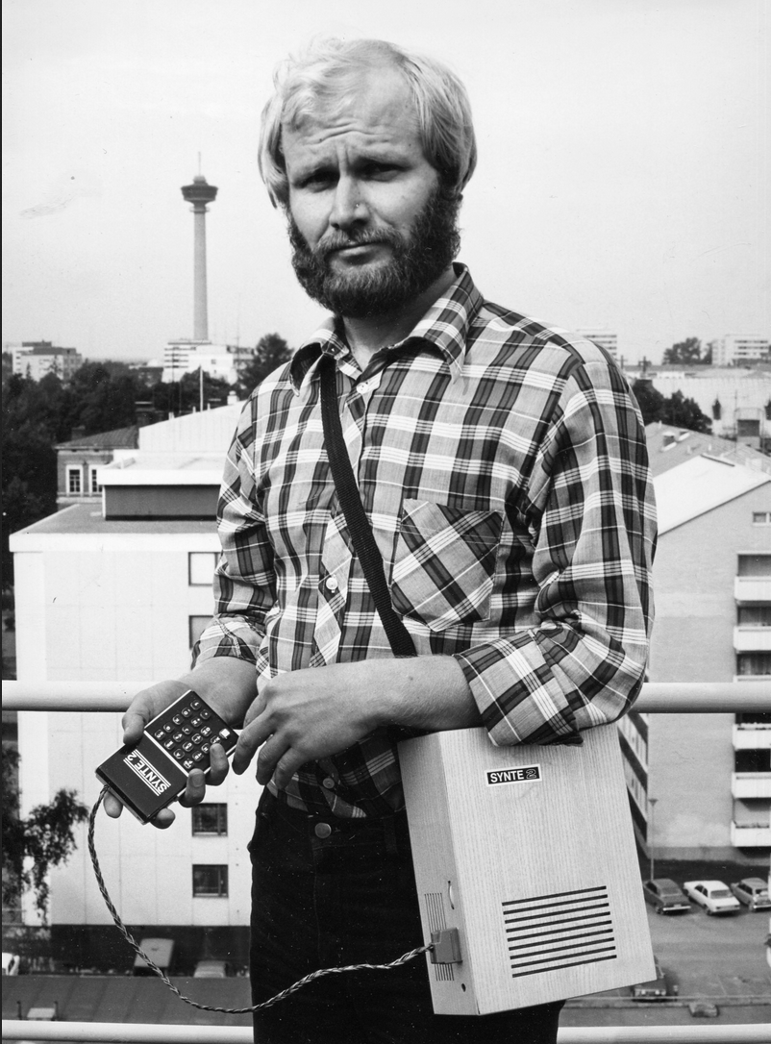
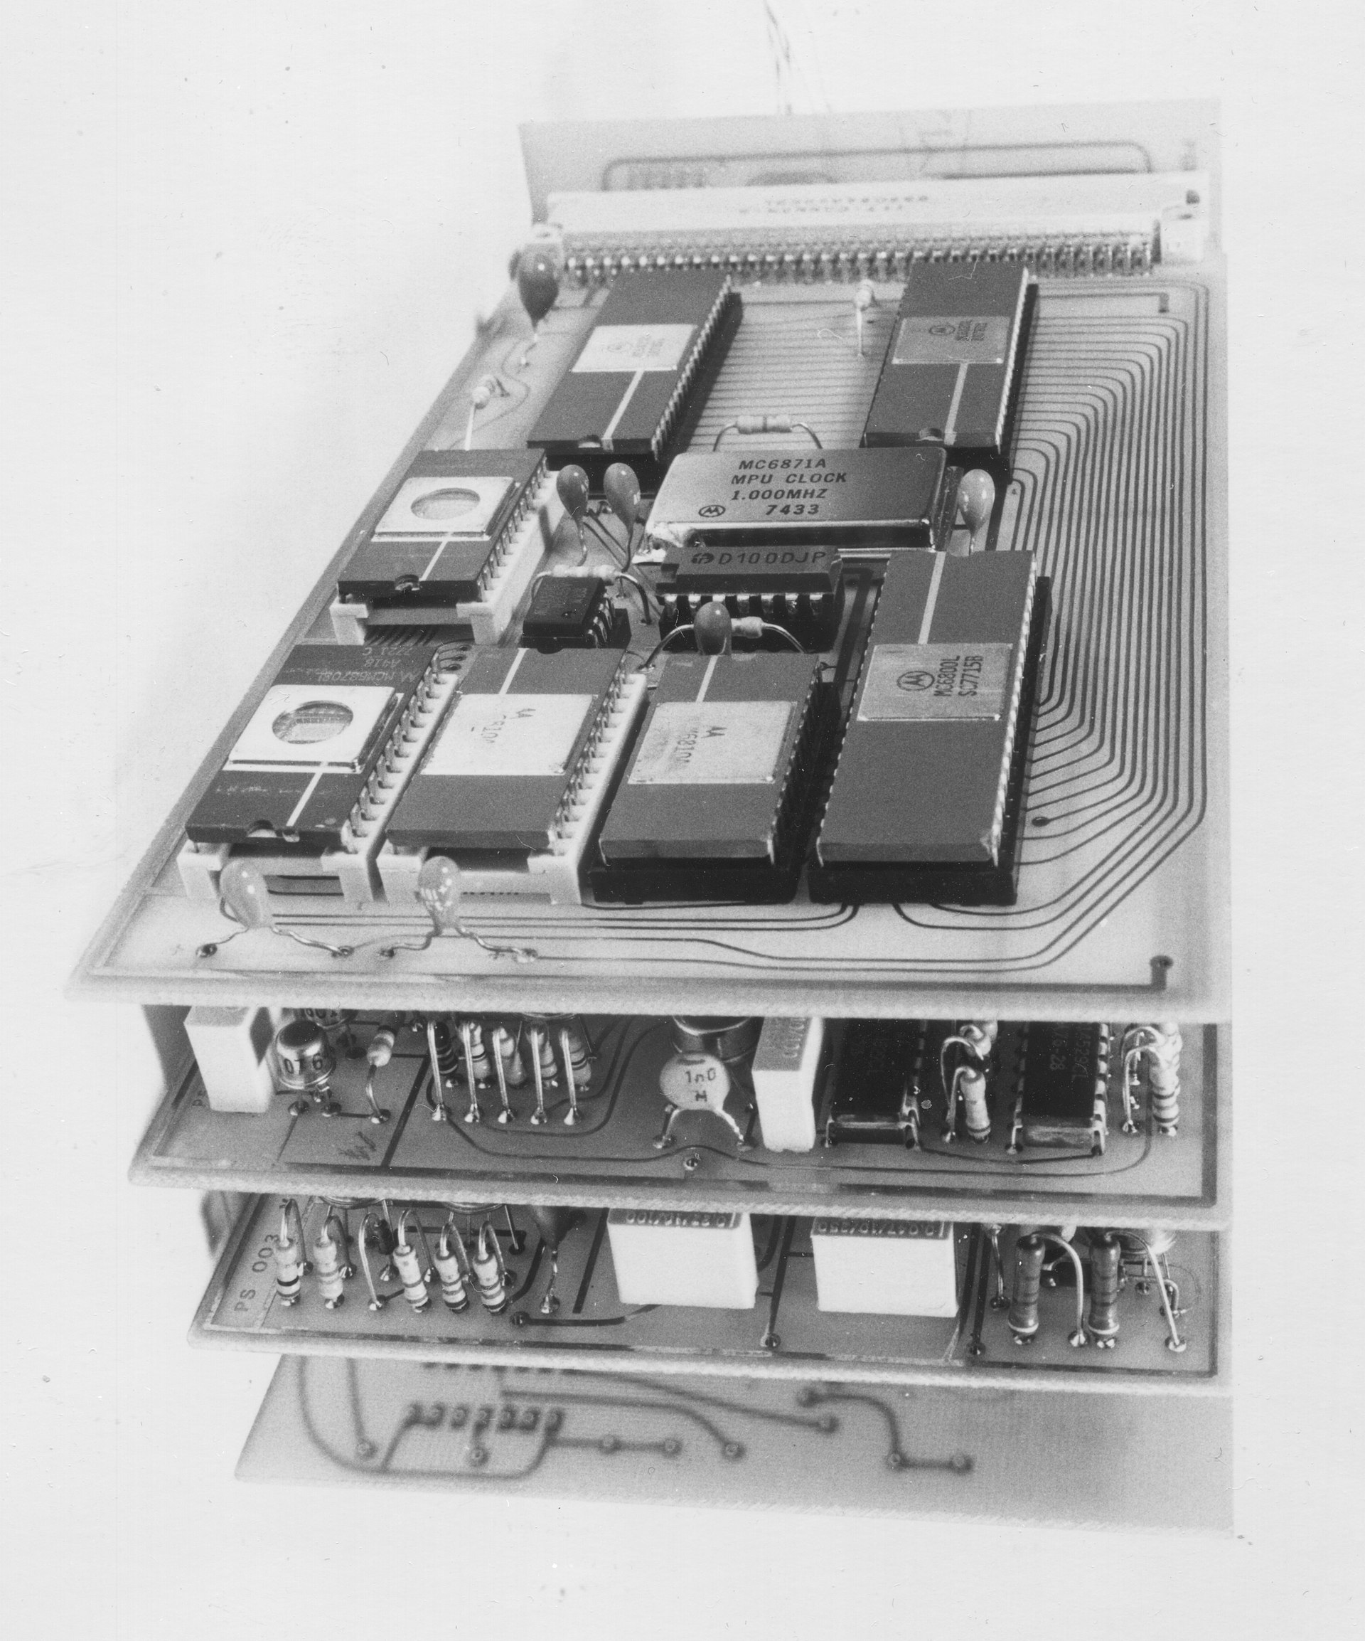
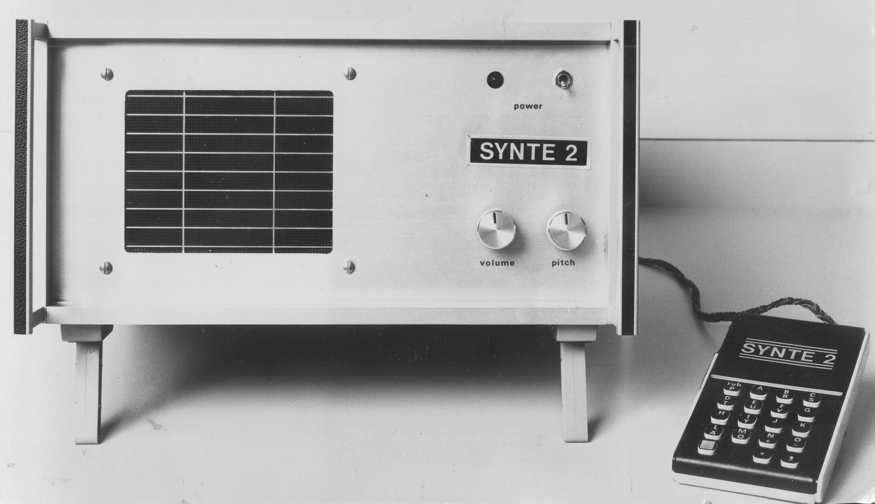
Some historical notes
1977: The first portable speech synthesis system in the world: SYNTE2.
Matti Karjalainen, Unto Laine et al. from Tampere University of Technology (!!) and Technical Research Centre of Finland.
Also one of the first synthesizers using microprocessors.

Slide 24
Part #2: Applications

Slide 25
Some major speech technology applications
Automatic speech recognition (”speech-to-text”)
Speech synthesis (“text-to-speech”)
Speaker identification and verification
Spoken language identification
Spoken language understanding
Speech coding (GSM, VoIP)
Speaker trait/state recognition (e.g., emotion recognition).
Speech analysis

Slide 26
Some major speech technology applications
Automatic speech recognition (”speech-to-text”)
Speech synthesis (“text-to-speech”)
Speaker identification and verification
Spoken language identification
Spoken language understanding
Speech coding (GSM, VoIP)
Speaker trait/state recognition (e.g., emotion recognition).
Speech analysis

Slide 27
Automatic speech recognition

Slide 28
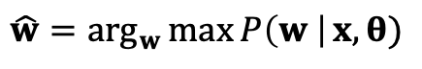
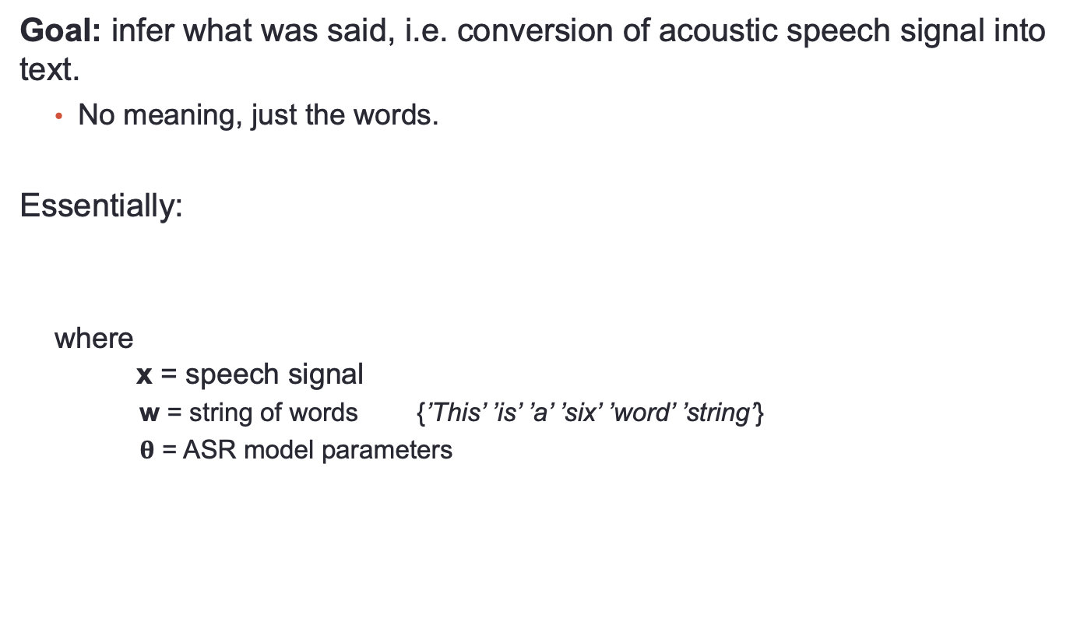
Automatic speech recognition (ASR)
Goal: infer what was said, i.e. conversion of acoustic speech signal into text.
No meaning, just the words.
Essentially:
where x = speech signal
w = string of words {’This’ ’is’ ’a’ ’six’ ’word’ ’string’}
$θ$ = ASR model parameters
$$\hat{w}=\arg_{w}\max{P\left(w \right|}x, θ)$$
→ Requires a some kind of model to estimate P(w | x)

Slide 29
What makes ASR non-trivial?
Acoustical variability of speech signals: nothing sounds the same.
High-dimensional output space.
English lexicon has ~40k words, so there are 40,000¹⁰ possible 10-word sentences.
Inflections in agglutinative languages such as Finnish etc…
Input space has the same linguistic complexity, but encoded in the time-varying acoustic signals.
Sequence-to-sequence problem: long inputs compared to outputs.
Average English word duration: 300 ms ≈ 30 feature frames.
Speech encodes several levels of structure (hierarchy, compositionality).
Access to speech data more limited than access to text in NLP.
Slide adapted from Peter Bell / CSTR Edinburgh

Slide 30
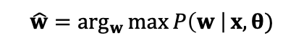
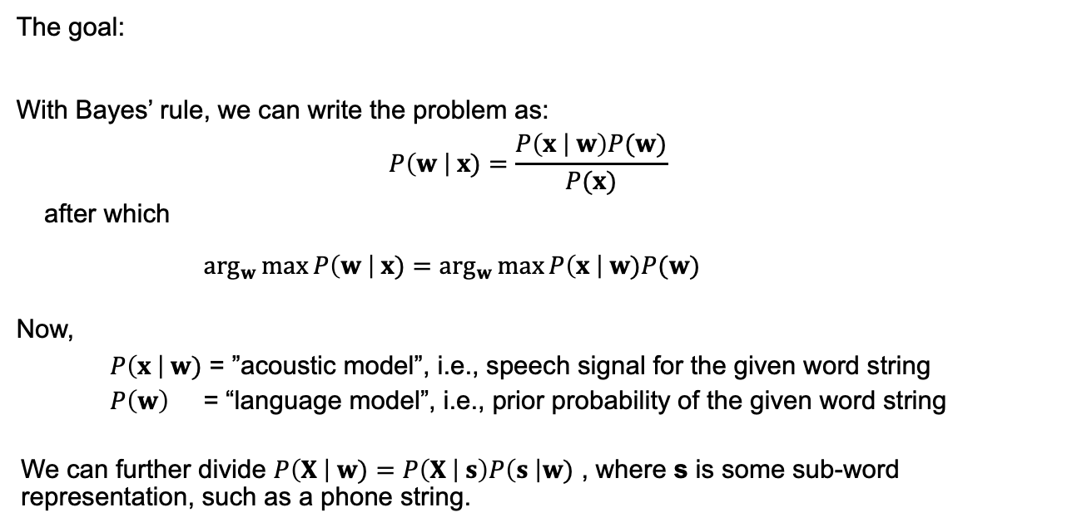
ASR as a statistical problem
The goal:
With Bayes’ rule, we can write the problem as:
$$P\left(w \right| x)=\frac{P\left(x | w\right)P(w)}{P(x)}$$
after which
$\arg_{w}\max{P\left(w \right| x)}=$ $\arg_{w}\max{P\left(x \right| w)P(w)}$
Now,
$P\left(x \right| w)$ = ”acoustic model”, i.e., speech signal for the given word string
$P\left(w\right)$ = “language model”, i.e., prior probability of the given word string
We can further divide $P\left(X \right| w)=P\left(X | s\right)P\left(s \right|w)$ , where s is some sub-word representation, such as a phone string.
$$\hat{w}=\arg_{w}\max{P\left(w \right|}x, θ)$$

Slide 31
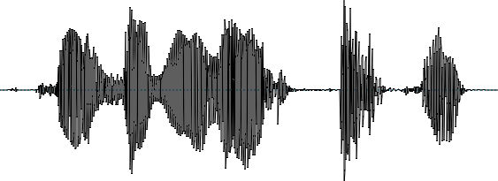
Automatic Speech Recognition (ASR)
training
speech data + labels
text data
recognition
Acoustic model
Pronunciation dictionary
Language model
input utterance
output text
Feature
extraction
Decoder
“Are you still following?”

Slide 32
Automatic Speech Recognition (ASR)
training
speech data + labels
text data
recognition
Acoustic model
Pronunciation dictionary
Language model
input utterance
output text
Feature
extraction
Decoder
“Are you still following?”
Acoustic model: how words or sub-word units sound, P(x | s)

Slide 33
Automatic Speech Recognition (ASR)
training
speech data + labels
text data
recognition
Acoustic model
Pronunciation dictionary
Language model
input utterance
output text
Feature
extraction
Decoder
“Are you still following?”
Acoustic model: how words or sub-word units sound, P(x | s)
Language model: probability of each word given the preceding words P(w | w_{t-1}, …, w_{t-n})

Slide 34
Automatic Speech Recognition (ASR)
training
speech data + labels
text data
recognition
Acoustic model
Pronunciation dictionary
Language model
input utterance
output text
Feature
extraction
Decoder
“Are you still following?”
Acoustic model: how words or sub-word units sound, P(x | s)
Language model: probability of each word given the preceding words P(w | w_{t-1}, …, w_{t-n})
Pronunciation dictionary: how sub-word units are mapped to words P(s | w), (e.g., /k/ /ae/ /t/ → “cat”),

Slide 35
Automatic Speech Recognition (ASR)
training
speech data + labels
text data
recognition
Acoustic model
Pronunciation dictionary
Language model
input utterance
output text
Feature
extraction
Decoder
“Are you still following?”
Acoustic model: how words or sub-word units sound, P(x | s)
Language model: probability of each word given the preceding words P(w | w_{t-1}, …, w_{t-n})
Pronunciation dictionary: how sub-word units are mapped to words P(s | w), (e.g., /k/ /ae/ /t/ → “cat”),
Decoder: puts all parts together to evaluate P(w | x)

Slide 36
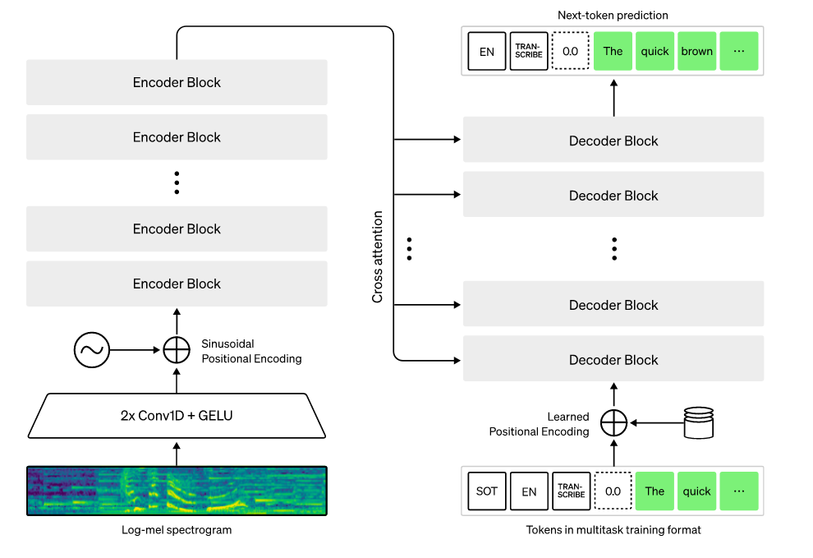
Neural end-to-end ASR with Whisper
https://openai.com/research/whisper

Slide 37
ASR demo
Try, e.g., voice control of ChatGPT or download Whisper from OpenAI to your own computer: https://github.com/openai/whisper

Slide 38
Speech synthesis

Slide 39
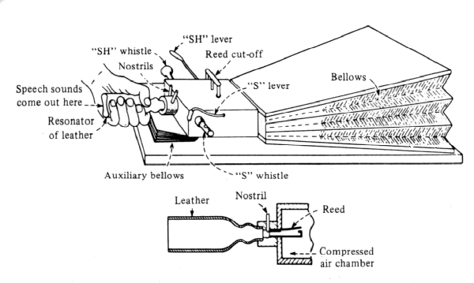
Speech synthesis
Generation of speech from text
Some use cases:
Hands- and eyes-free interfaces (e.g., Siri, ChatGPT, cars etc.)
Assistive technologies (for speech-impaired)
Social robotics
Entertainment (e.g., computer games)
Speech-to-speech translation
Speech production research
Von Kempelen synthesizer from late 18th century.

Slide 40
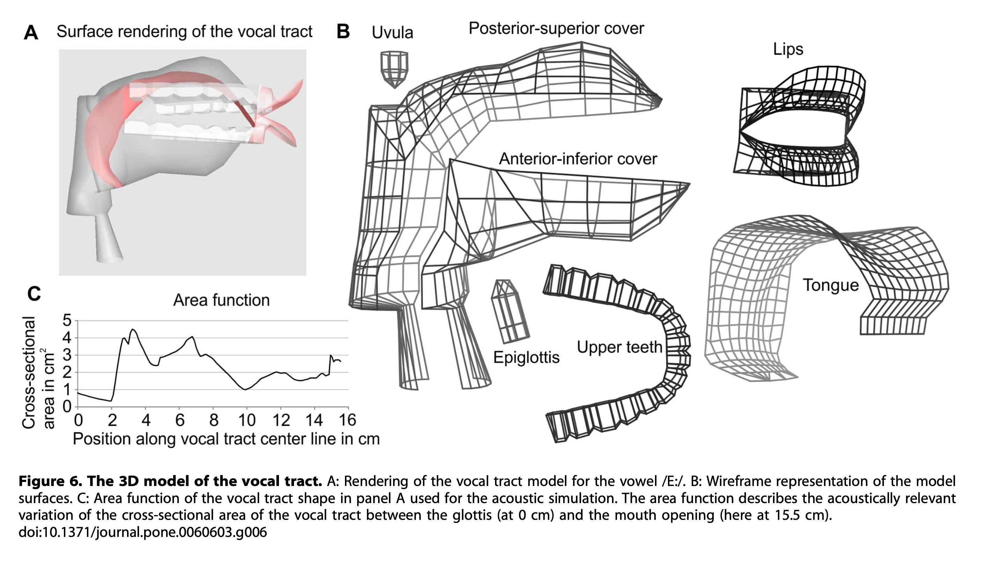
Articulatory speech synthesis
Generation of speech signals by modeling the physiology and acoustics of the vocal tract.
Used primarily for speech research.
Examples:
https://www.vocaltractlab.de/index.php?page=vocaltractlab-examples
https://ai.vub.ac.be/levi-demo/LeVI.html
https://dood.al/pinktrombone/

Slide 41
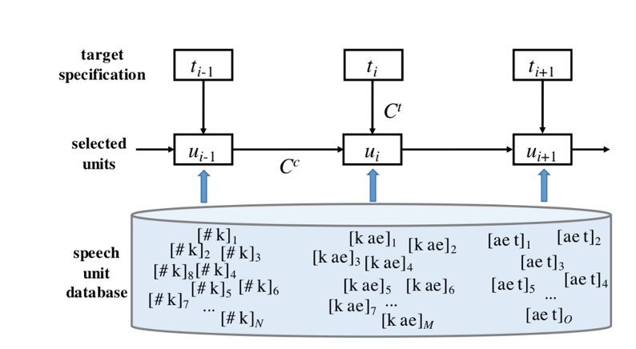
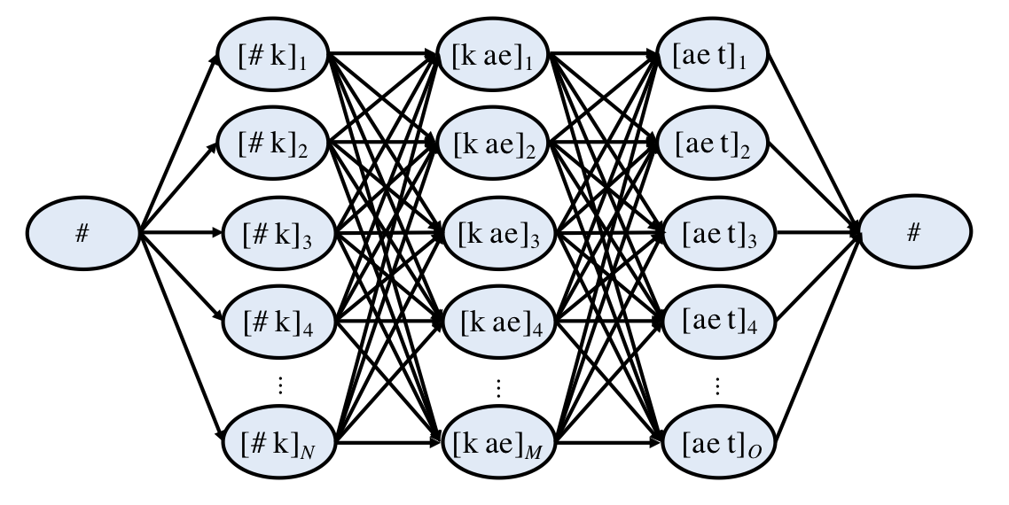
Concatenative speech synthesis
Also known as unit selection synthesis: combination of pre-recorded speech segments (units) to create a desired signal.
Built using a large speech corpus from one professional speaker.
Unit selection is based on cost optimization between the intended signal and available units.
Target cost: try to find correct sound with correct prosody.
Concatenation cost: ensure seamless transitions between sounds?
Can be solved together as a dynamic programming problem.

Slide 42
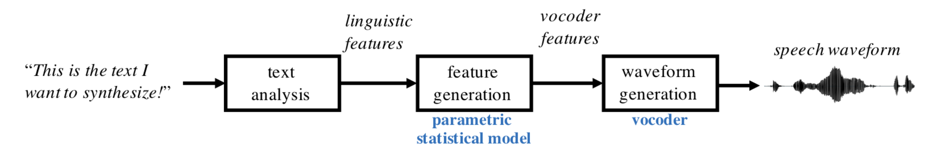
Statistical parametric speech synthesis
Step 1: Generate linguistic features from text
Step 2: Generate acoustic features from the linguistic features
Step 3: Generate acoustic waveform from the speech features
Almost like ASR inverted!
(waveform to features, features to lingustic units, linguistic units to text).

Slide 43
Statistical synthesis: text analysis
Written language does not specify how something should be spoken.
Missing details on pronunciation, rhythm and tempo, intonation, stress patterns etc…
Text analysis module tries to ”invent” the best way to speak out the given text.
Technically: mapping from letters of text to linguistic features
Minimally: speech sounds (phones) and their duration and intonation.
Can be rule-based or statistical.

Slide 44
Statistical synthesis: feature generation
Spectral features from an acoustic model (a generative machine learning model)
Model generates a sequence of acoustic features for a sequence of linguistic units.
Trained in advance using a speech database.

Slide 45
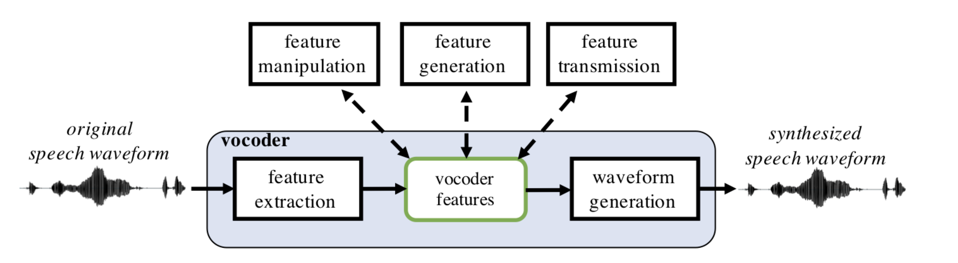
Statistical synthesis: vocoding
Once the acoustic features exist, a vocoder is used for waveform generation.
Vocoder = an algorithm that can decompose speech into features (analysis) and reconstruct the signal back from them (synthesis).
SPSS acoustic model
Figure: A schematic view of a generic vocoder.

Slide 46
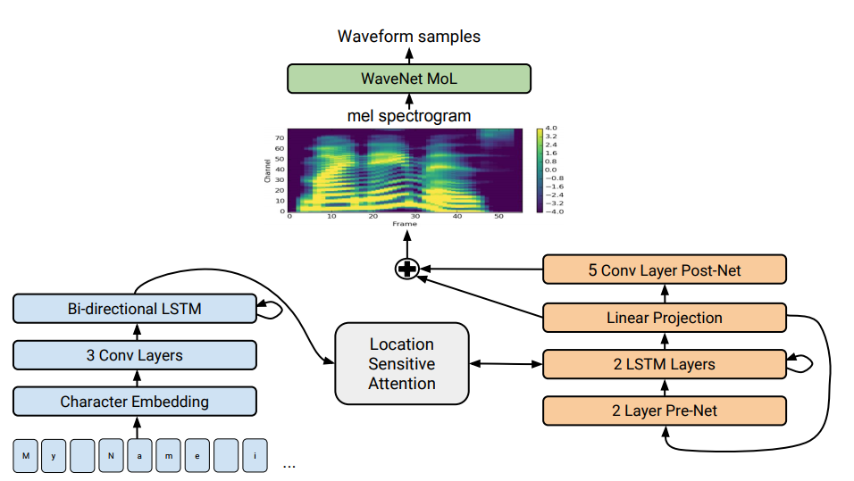
Neural end-to-end synthesis
Tacotron2 (Shen et al., 2018): neural network to generate mel spectrograms directly from text.
WaveNet (van den Oord et al., 2016): neural network to generate waveforms from mel spectrograms.
Can be combined to get fully end-to-end text-to-speech system.

Slide 47
Neural synthesis demo
https://cloud.google.com/text-to-speech?hl=fi

Slide 48
Paralinguistic speech processing

Slide 49
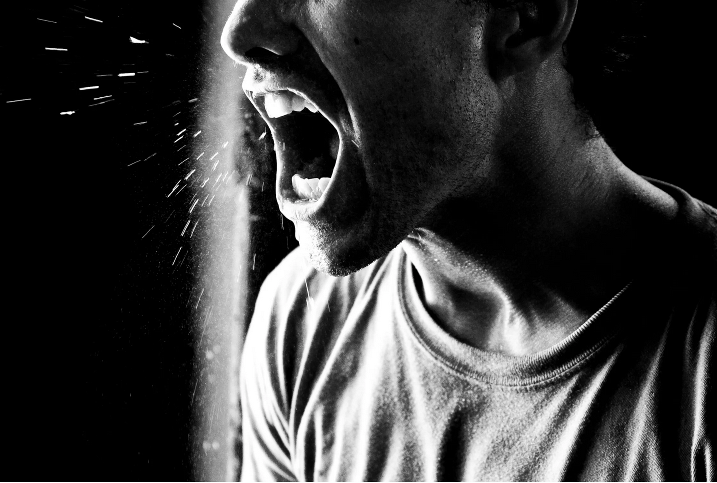
Paralinguistic?
para = ”along”, “beyond”, linguistic ~ “literal content of the language”
Paralinguistic speech processing (PSP):
Speech analysis and processing besides the literal message.
Factors in speech:
What is said (~ content).
Who is talking (~ identity)
How things are said (~ style).
States and traits of the speaker (e.g., health, age, emotions, dialect, social class, attitude…)
Where is speech captured (~context/environment)
Everything mixed together in the same signal.
From Getty
Typical questions in computational paralinguistics

Slide 50
Sources of variation in speech production
Neurophysiology
Status: stress, short-term illness, intoxication, fatigue, anxiety, depression
Pathology: neurodegenerative diseases affecting muscle control (Parkinson’s disease) or memory (Alzheimer’s), aphasia, CP, other trauma to brain or vocal organs etc.
Personal traits
Dialect, social class & other language background
Personality traits
Gender
Personal states:
Emotions & enthusiasm
Attitude
Confidence
Social constructs:
Addressee (e.g., infant vs. adult-directed speech, power relations)
Trustworthiness
Convincingness
Level of conflict
…

Slide 51
A simple PSP system (standard supervised learning)
Training
speech signals
Feature
extraction
Classifier
model
para-meters
class
labels
[happy], [angry], [sad]
Usage (testing)
P(happy | speech)
Feature
extraction
Classifier
P(angry | speech)
P(sad | speech)

Slide 52
Time-scales of paralinguistic phenomena
States vs traits (see also Schuller et al., 2013).
Some properties vary quickly in time and may depend on the communicative context (e.g., affective state, attitude, non-communicative signals)
Some have medium duration (intoxication, temporary diseases, mood etc.)
Some change slowly or are permanent (speaker personality, ethnic/group membership etc.)
Time-scale should be taken into account in automatic analysis and recognition.
Suboptimal to perform short-term (e.g. millisecond-scale) recognition of temporally stable phenomena (e.g., seconds, minutes)

Slide 53
Utterance-level features with functionals
PSP classifier
A fixed-dimensional (m x d) feature vector
m different statistical “functionals” across all t:
mean, variance, max, min etc…
Short-term features f(t)
dim(f) = d
Acoustic waveform x(t)

Slide 54
Computational Paralinguistics Challenges (ComParE)
A series of challenges in paralinguistic classification held annually since 2009:
http://compare.openaudio.eu/
Typically multiple parallel tasks in each challenge.
Some data sets only available to participants of the challenges, some are openly available.
Provides nice benchmarks for many tasks.

Slide 55
Computational Paralinguistics Challenges (ComPArE)
Typical performance measures:
Detection: area under the curve (AUC) for detection
Classification: unweighted average recall (UAR %) for classification
Regression: Pearson correlation (r)
Some old ComParE baselines:
Laughter / filler detection (AUC ~ 83%).
Emotion 12-category recognition: 40.9% unweighted average recall (UAR)
High vs. low conflict (83.3% UAR)
Native language 11-category classification (47.5% UAR)
Deceptiveness 2-class classification (68.3% UAR)
Infant vs. adult-directed speech (70.2% UAR).

Slide 56
Summary

Slide 57
Summary
Speech is a rich acoustic signal with special properties, evolved for communicative efficiency between humans.
Speech conveys multiple layers and types of information in parallel.
Speech processing deals with machine analysis, transformation, transfer, and generation of speech data.
Next session: speech production and the basic structure of speech signals

